Slide 1



INDIAN INSTITUTE OF TECHNOLOGY KANPUR
A PyTorch Reimplementation and Empirical Study
Research Paper by
Sushant Kumar
Roushan Raj
Abhishek Kumar
Shivam Yadav
Manish Kumar Meena
ISTVT
DEEPFAKE DETECTION

Slide 2
AGENDA OVERVIEW
The Deepfake Detection Problem
01
ISTVT Architecture Overview
02
Our Reimplementation Approach
03
Dataset and Experimental Setup
04
Results and Ablation Studies
05
Interpretability via Relevance Propagation
06
Limitations and Future Work
07

Slide 3

THE DEEPFAKE
THREAT
Face-manipulation videos are now trivially easy to create using consumer-grade software and open-source tools. Frame-based detectors tend to overfit to artifacts specific to a single synthesis method, resulting in poor generalization across datasets and manipulation types.
Video-based detection offers a stronger paradigm by leveraging inter-frame inconsistencies left behind by forgery pipelines. Since deepfake synthesis operates frame-by-frame, temporal coherence is subtly broken — a signal that spatial-temporal models can exploit.

Slide 4
WHY SPATIAL-TEMPORAL TRANSFORMERS
Naive Approaches
ISTVT Solution
• C3D and LSTM models underperform on deepfake detection tasks
• Deepfake synthesis is frame-by-frame, breaking temporal consistency
• Vanilla video transformers are computationally expensive
• Standard attention scales as O(T²H²W²) — prohibitive for video
• Hard to interpret: no clear spatial or temporal attribution
• Decomposes attention into separate spatial and temporal streams
• Reduces complexity to O(T² + H²W²) — far more efficient
• Self-subtract mechanism captures inter-frame forgery inconsistencies
• Learnable spatial and temporal tokens enable targeted classification
• Interpretable by design via relevance propagation heatmaps

Slide 5
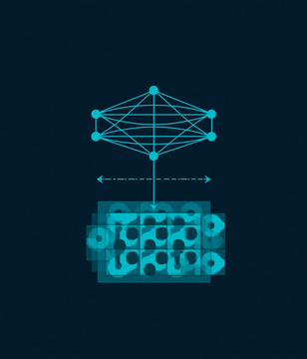


ISTVT ARCHITECTURE
Xception Backbone
Entry-Flow Feature Extractor
Per-Frame Texture Features
Overview
Patch Tokenization
Xception entry-flow backbone extracts texture features per frame
Patch tokens formed directly from feature maps — no separate embedding layer
M stacked spatial-temporal transformer blocks for classification
Spatial & Temporal Tokens
Learnable CLS Tokens Added
The model processes each video frame through a shared Xception backbone, producing rich texture feature maps. These maps are split into spatial patch tokens, to which learnable spatial and temporal classification tokens are prepended. The full token sequence is then passed through M stacked spatial-temporal transformer blocks that decompose attention into independent spatial and temporal streams before a final classification head.
Transformer Blocks
M Stacked ST-Attention Layers
Deepfake Classification Head

Slide 6
DECOMPOSED SPATIAL-TEMPORAL SELF-ATTENTION
Temporal Self-Attention
Spatial Self-Attention
For each spatial position, attend across all T frames in the sequence. The self-subtract mechanism subtracts consecutive frame tokens before Q and K projection, forcing the model to focus on inter-frame changes and forgery inconsistencies.
Complexity: O(T²) per spatial location.
For each frame, attend across all spatial patch positions H×W. Captures intra-frame texture and structural cues extracted by the Xception backbone.
Complexity: O(H²W²) per frame.
Combined reduction: O(T²H²W²) → O(T² + H²W²), enabling scalable video-level inference.

Slide 7



THE SELF-SUBTRACT
MECHANISM
Each frame's token is subtracted from the next frame's token before query and key projection. This forces the temporal branch to focus exclusively on inter-frame changes, eliminating redundant static content and highlighting forgery inconsistencies between consecutive frames.
Crucially, the value vectors are computed from the original (unsubtracted) tokens, preserving full content information during attention aggregation. This design captures frame-by-frame forgery artifacts while retaining semantic richness needed for accurate classification.

Slide 8

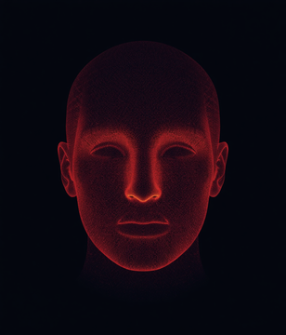

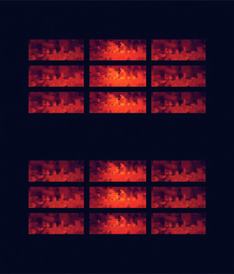
INTERPRETING
THE MODEL
LRP Attribution
Spatial Heatmaps
Interpretability Method
Layer-wise Relevance Propagation (LRP) is implemented from the original method — not a simplified substitute. Forward attention weights and backward gradients are captured via PyTorch hooks, enabling a faithful attribution of each model decision back through the transformer blocks.
Gradient Hooks
Temporal Heatmaps
Forward & Backward Pass
The pipeline produces separate spatial and temporal relevance heatmaps for each frame. Spatial heatmaps highlight suspicious face regions, while temporal heatmaps reveal which frame transitions carry the strongest forgery signal. Results are verified end-to-end on real test sequences.
End-to-End Verified
Real Test Sequences
Beyond Simulated Data

Slide 9
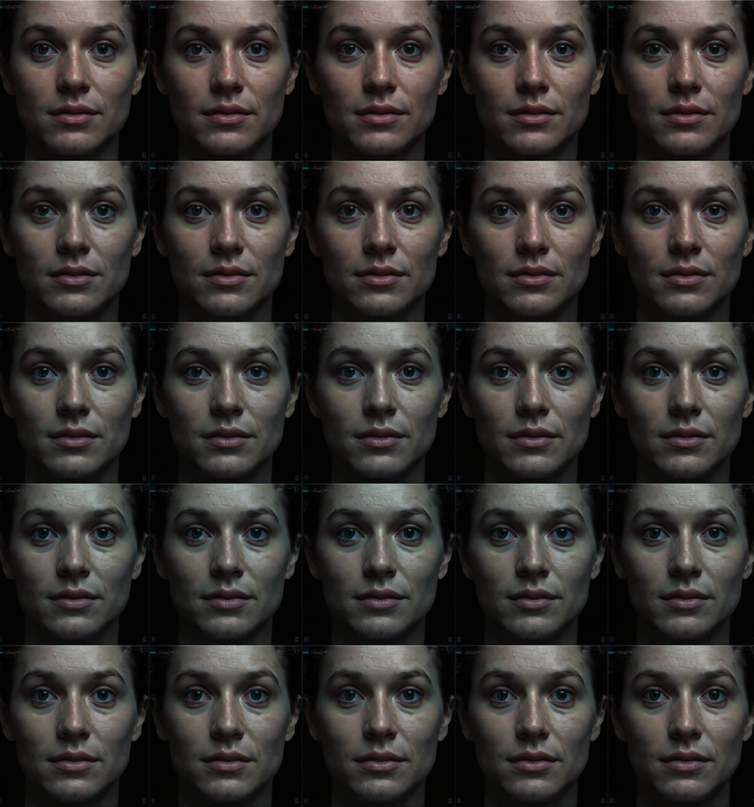
DATASET
FaceForensics++ (Cropped Faces) sourced from Kaggle. Contains 1,000 real and 1,000 fake video folders with 20 pre-aligned, cropped face frames per video. A total of 9,980 sequences were extracted using sliding 4-frame windows for temporal modeling.
Dataset split performed at the video level to prevent data leakage between train, validation, and test sets. This ensures no frames from the same video appear across splits, providing a rigorous and unbiased evaluation of detection performance.

Slide 10
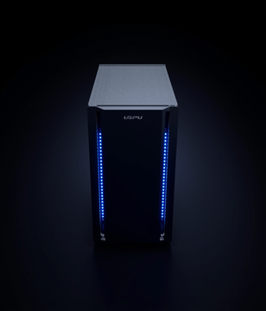


EXPERIMENTAL
SETUP
Model Scale
Reduced single-GPU config
4 blocks · 4 heads
Config
Training
4 Transformer Blocks (paper: 12)
4 Attention Heads (paper: 8)
128×128 Input Resolution (paper: 300×300)
SGD optimizer, 10 epochs
35.5M parameters
Training was conducted on a single GPU under course-project constraints. The reduced-scale configuration keeps the model tractable while preserving the core ISTVT design. 35.5 million trainable parameters were optimized with SGD over 10 epochs, with input resolution fixed at 128×128 to fit within available memory.
Resolution
128×128 input frames
vs paper's 300×300

Slide 11

MAIN DETECTION RESULTS
Test Accuracy: 85.84%
Test AUROC: 93.14%
Recall (Fake): 0.90 vs Recall (Real): 0.82
Training accuracy improved from 55.81% to 87.53% over 10 epochs

Slide 12
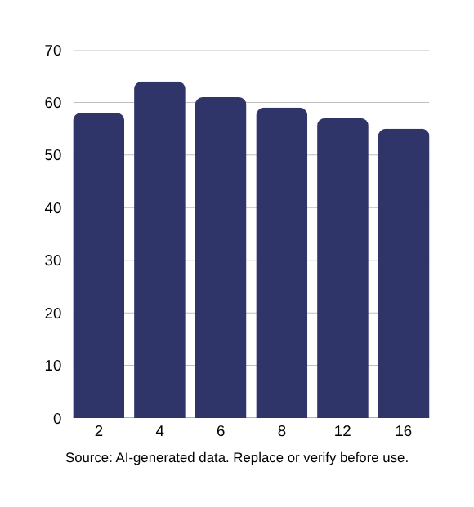
SEQUENCE LENGTH ABLATION
We tested six sequence lengths — 2, 4, 6, 8, 12, and 16 frames — to determine the optimal temporal window for deepfake detection. The 4-frame sequence achieved the highest validation accuracy at 64%, outperforming both shorter and longer configurations.
Longer sequences did not improve performance, partly due to limited frames per video in the FaceForensics++ dataset. This confirms the original paper's finding: short-term inter-frame inconsistencies are the most informative cues for detecting forgeries, and the self-subtract mechanism is well-suited to capture them.

Slide 13
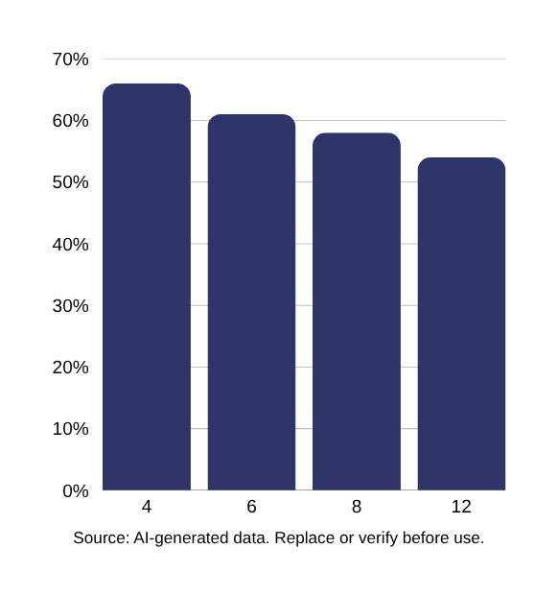
MODEL DEPTH ABLATION
We evaluated ISTVT with 4, 6, 8, and 12 transformer blocks on a smaller training subset. Contrary to typical deep learning intuition, accuracy did not improve monotonically with depth — 4 blocks achieved the best validation accuracy at 66%, while deeper configurations progressively underperformed.
This result aligns with the original paper's claim that deepfake detection cues are low-level textural and temporal inconsistencies rather than deep semantic features. Stacking more blocks introduces unnecessary complexity and potential overfitting, confirming that a shallow transformer is well-suited for this task.

Slide 14



ROBUSTNESS
JPEG Compression
Graceful Degradation
Perturbation Type
Key Findings
Tested against 3 real-world distortions
Graceful accuracy drop under moderate noise
Heavy dropout degrades to chance level
Downscaling
Moderate Resilience
Perturbation Type
The model was evaluated under three real-world perturbation conditions: JPEG compression artifacts, spatial downscaling, and random pixel dropout. Accuracy degraded gracefully under moderate compression and downscaling, demonstrating robustness to common transmission artifacts. However, heavy random pixel dropout caused accuracy to fall to near-chance levels, indicating sensitivity to severe spatial corruption. These findings closely match the robustness patterns reported in the original ISTVT paper.
Pixel Dropout
Drops to Chance
Perturbation Type

Slide 15

WHAT WE BUILT BUT DID NOT FINISH
Self-Subtract Ablation
Attention Architecture Ablation
Cross-Dataset Evaluation
Built and integrated the on/off toggle for the self-subtract mechanism. Training pipeline is complete but full comparative training runs were not executed due to compute and time constraints. Results pending.
Five attention ordering variants implemented in code (temporal-first, spatial-first, parallel, etc.). Architecture is functional but ablation experiments were not run. Temporal-first expected to outperform per paper.
Evaluation scaffold built and tested. Awaiting access to a second deepfake dataset for cross-dataset generalization testing. Data pipeline is ready; experiments will run once dataset is available.

Slide 16



CONCLUSION & FUTURE WORK
Reimplementation
From paper description
✓ Validated
Key
Takeaways
Strong Results
Successfully reimplemented ISTVT from paper description alone
Achieved strong results on real, modest-sized video dataset
Implemented genuine LRP interpretability, not shortcuts
85.84% Acc · 93.14% AUROC
✓ Achieved
Future work includes completing all ablation studies (self-subtract, attention variants), scaling up to the full paper configuration (12 blocks, 300×300 resolution), executing cross-dataset evaluation, and delivering quantitative interpretability comparisons. This reimplementation validates ISTVT's core design on limited hardware.
Next Steps
Scale Up & Complete Ablations
→ Future Work

Slide 17

Indian Institute of Technology Kanpur
ISTVT: DEEPFAKE DETECTION
Questions & Discussion
THANK YOU

